Slide 1
WELCOME

Slide 2
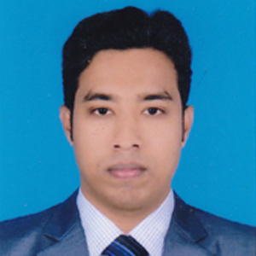
MD.SHOWMIQUE ISLAM
INSTRUCTOR,ENGLISH
Sapahar Govt. Technical School and College
Sapahar,Naogaon
CLASS:SEVEN
SUBJECT: ENGLISH GRAMMAR
PRONOUN

Slide 3
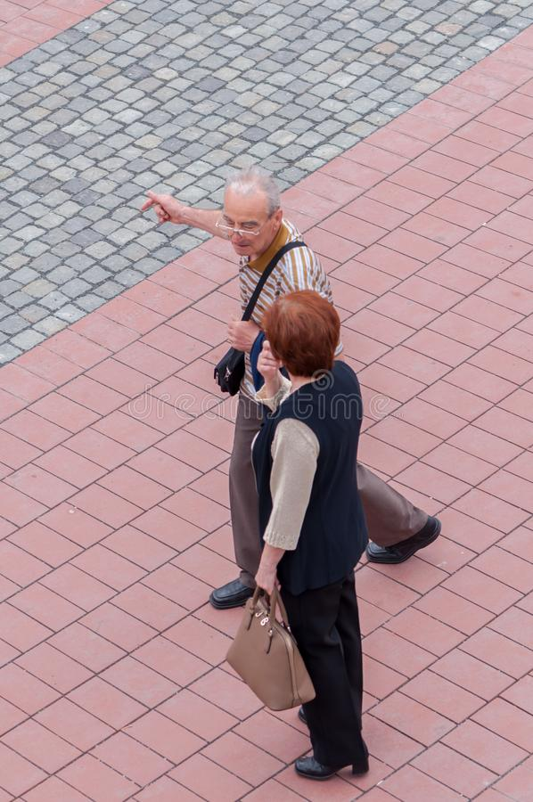
He

Slide 4
They

Slide 5
Our today’s lesson is …
Pronouns
Unit-1

Slide 6
Learning outcomes
After this lesson the students will be able to …
1. ask and answer questions.
2. use pronoun in the text.
3. find out pronoun from sentence.

Slide 7
A. Look at the underlined words in the following texts:
a: Mr. Ahmed is reading a book. It is very interesting.
b: Students of this school are very disciplined. They all stay in the hostel.
c: The game teacher asked players to go to the field in the afternoon. But nobody was there.

Slide 8
B. Look at the pronouns in the box:
I you she they we nobody it who
Pronouns have three forms namely subjective, objective and possessive. Look at the table….
Subject Form | Object Form | Possessive Form
I | Me | My , Mine
We | Us | Our, Ours
You | You | Your, Yours
They | Them | Their, Theirs
He | Him | His
She | Her | Her, Hers
It | It | its

Slide 9
C. Look at the following sentences:
My brother is healthy. He weights 75 kg. Ms Shaila works in a bank. She has doing this job for the last 15 years.
D. Now use personal pronouns in the following text:
Maruf’s father is a businessman . _____has been in business for about 15 years. Currently in his farm, there are 20
people working full time. _____has three children who are going to school. Maruf is ____second child, the youngest
And eldest are both ____daughters.
He
He
his
his

Slide 10
HOME WORK
Make the sentence using Subject Form Pronouns.

Slide 11
Thank You

